Slide 1
Phylogenetic and phylogeographic meta-analysis of African arthropod cytochrome c oxidase 1 barcode sequences submitted into the Barcode of Life Database
Gilbert Kibet-Rono*
Caleb Kibet, Jean-Baka Domelevo Entfellner, Steven Nyanjom, Daniel Masiga, Scott Miller, Jandouwe Villinger
Notes:
‹#›

Slide 2
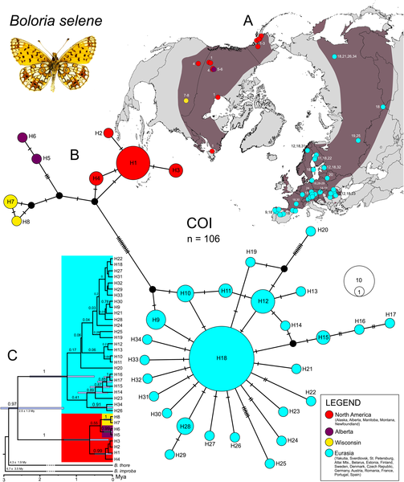
Evolution and population dynamics of arthropods
Phylogeography: Studies evolutionary and population dynamics and processes behind them
Population dynamics: migration, range separation, gene flow, population size
biotic factors - predation
abiotic factors - climate oscillation
Phylogenetics: Population structure
Understanding population dynamics of arthropods (Insects) lead to better pest and vector management
Maresova et al. (2019)

Slide 3
Background
Mitochondrial cytochrome c oxidase subunit 1 gene (COI), ~658 base-pair, is used for molecular identification of most animal phyla
The Consortium for the Barcode of Life (CBOL), May 2004: Rapid and inexpensive identification of species using standard DNA barcodes
International Nucleotide Sequence Database Collaborative (INSDC)
Barcode of Life Database (BOLD)
Over 320,000 African COI arthropod sequences published in BOLD
43,245 unpublished records from Kenya

Slide 4
Rationale
Problem statement:
Few studies exists on African insects
lack of comprehensively sampled data and
a well-developed/documented bioinformatics workflow
Objectives:
Develop a well documented bioinformatics workflow for phylogenetic and phylogeographic analysis of Insects sequences
Implement the use of COI barcode sequences retrieved from BOLD.

Slide 5





Methodology
DATA RETRIEVAL
3. Bioinformatics Pipeline
BOLD Public Data API
wget > XML
Data Preprocessing:
AWK/sed/egrep > FASTA
Sequence classification
RDPClassifier & BLAST
Multiple Sequence Alignment MSA
MAFFT, PASTA, MUSCLE, OPAL T-COFFEE > FASTA/Phylip/clw
Phylogenetic Inference:
FastTree & RAxML > Newick/PhyloXML/NEXUS
Population Structure:
POPART, GENELAND, ARLEQUIN
Phylogeography:
BEAST2/BASTA
Others: Biopython, PGDspider
2. DATA MINING
Data transformation:
BeautifulSoup4, pandas > TSV
Data analysis, cleaning & sorting:
R tidyverse package > TSV files & statistics

Slide 6
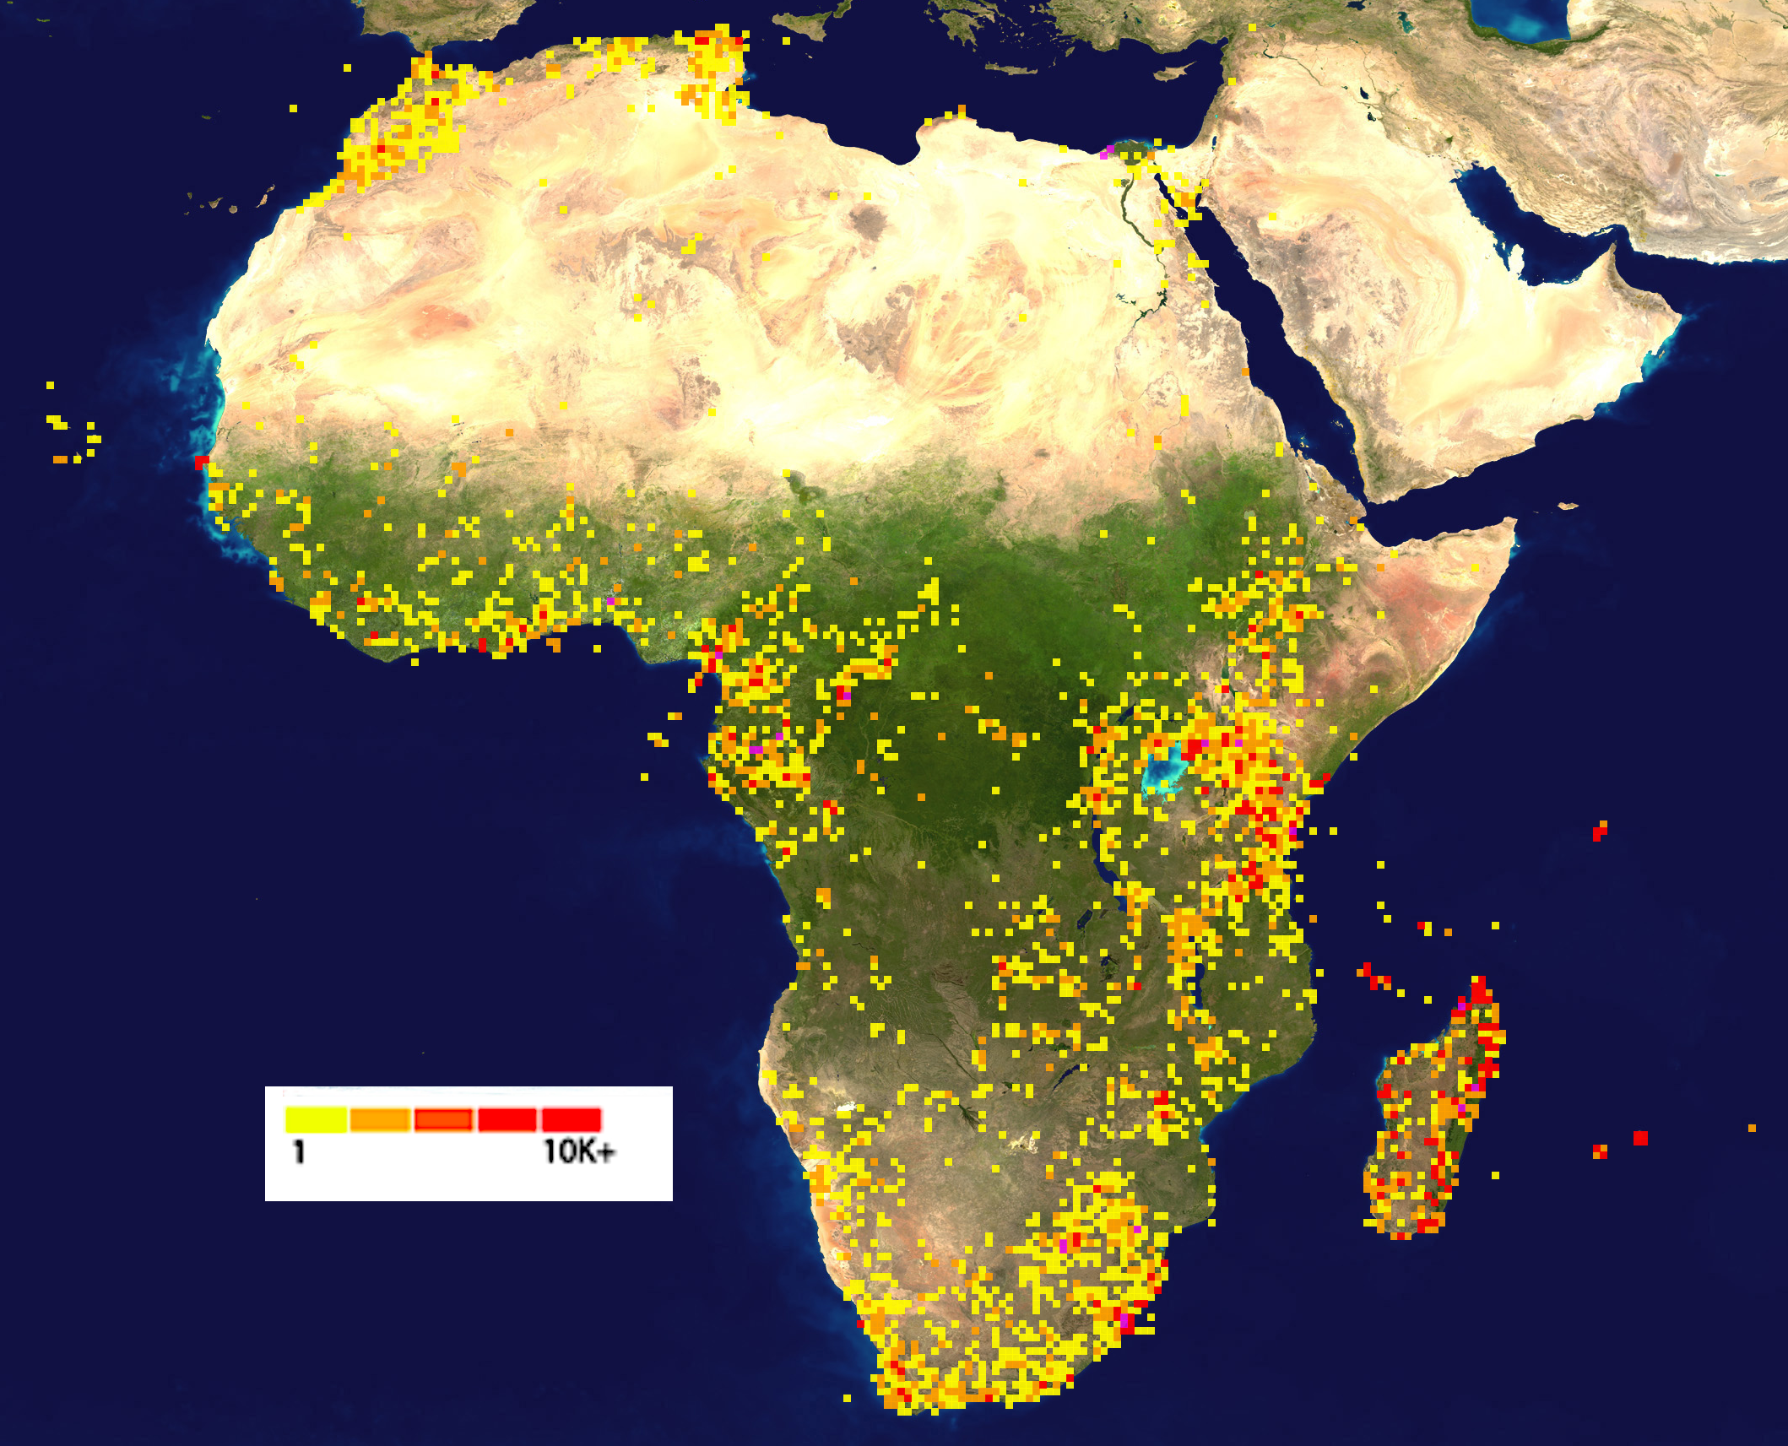
Results: data
323,034 “arthropod” COI sequences from Africa, 81,328 are from East Africa, 76.3% are arthropoda, 60% are Insecta
Class Insecta orders | Frequency
Lepidoptera (80 families) | 76275
Diptera (61 families) | 48137
Hymenoptera | 40902
Coleoptera | 12323
Hemiptera | 8116
Orthoptera | 1890
Odonata | 1571
Psocodea, Blattodea, Mantodea, Trichoptera, Thysanoptera, Neuroptera, Ephemeroptera, Ephemeroptera, Dermaptera | 3557
Embioptera, Phasmatodea, Plecoptera, Strepsiptera, Mecoptera, Zygentoma | 69
Undefined | 11

Slide 7
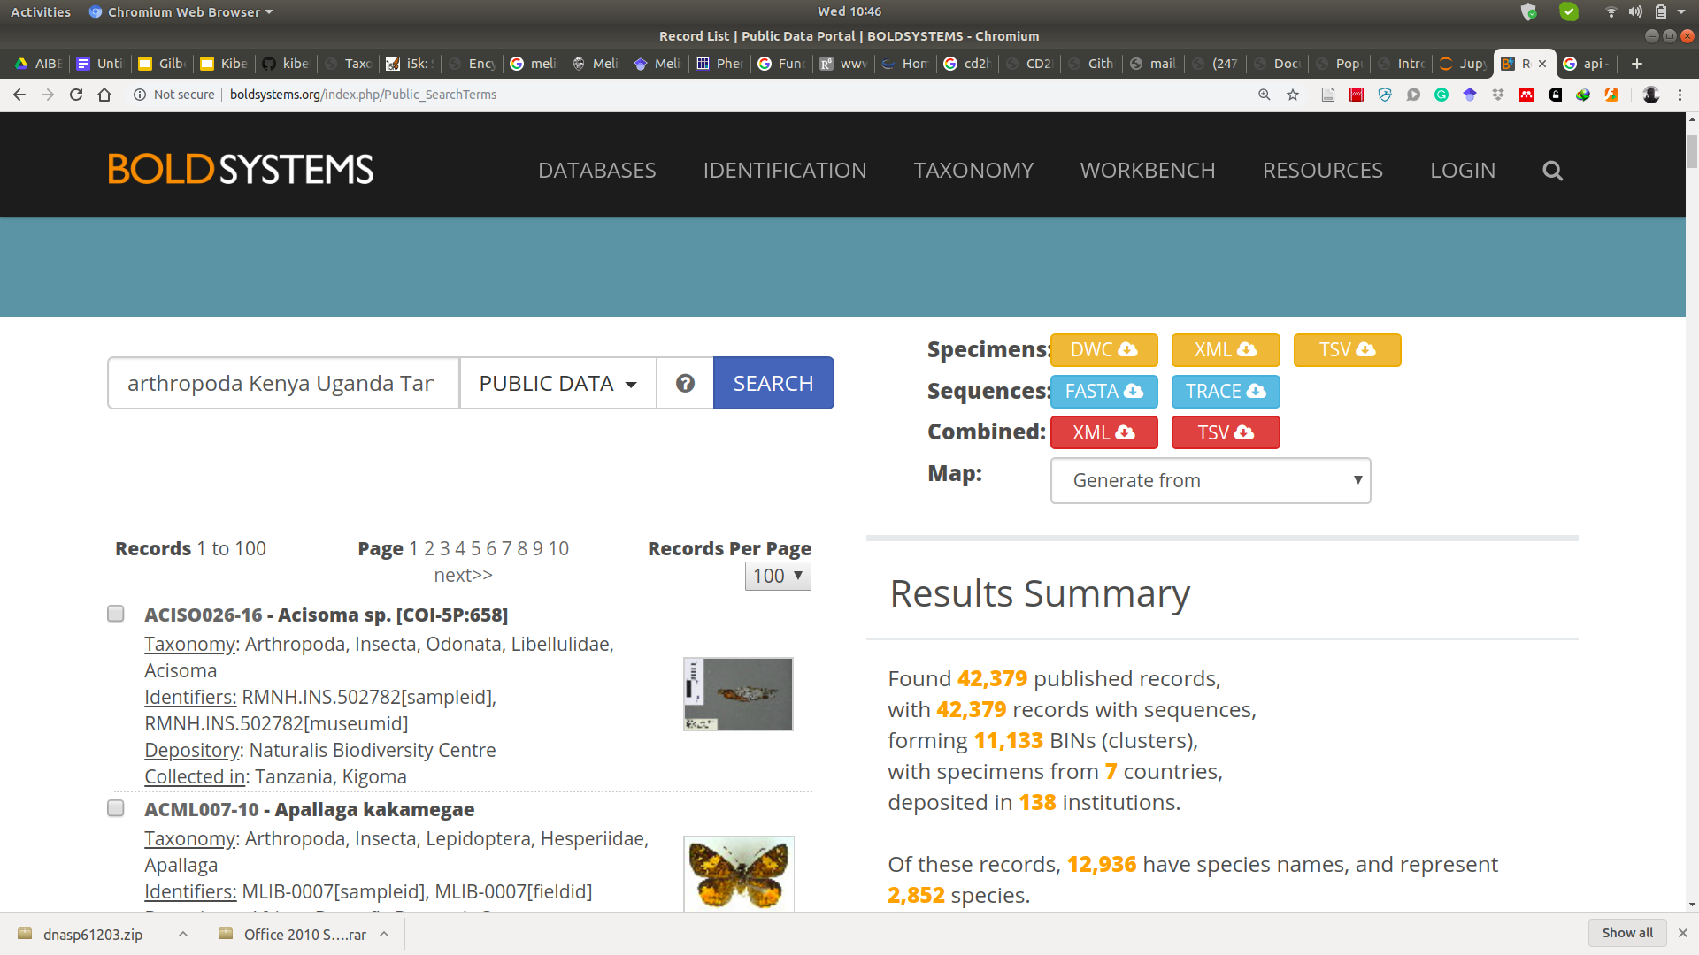
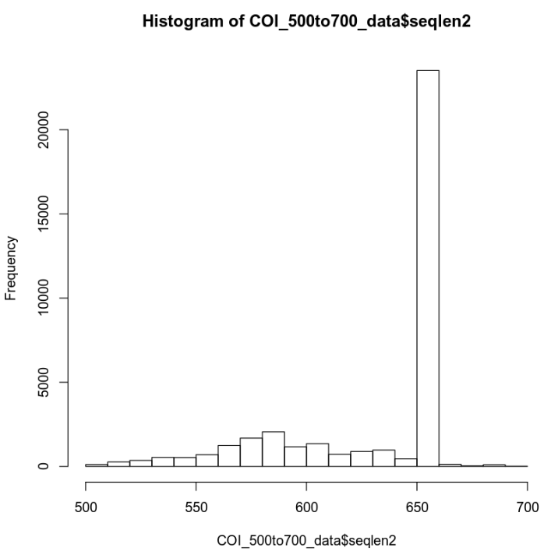
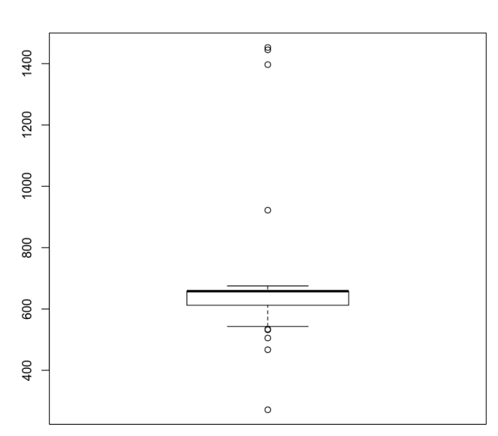
Data Retrieval, Transformation and sorting
Server/
cluster/
pc
Data Retrieval:
Application Programming Interface (API) - XML files
API
Data Transformation:
A pandas dataframe of 84 columns and as many rows as records
XML files
Beautifulsoup4
Pandas
TSV files
Summary analysis & Sorting by seq. length
Whole data set
sorted Data

Slide 8
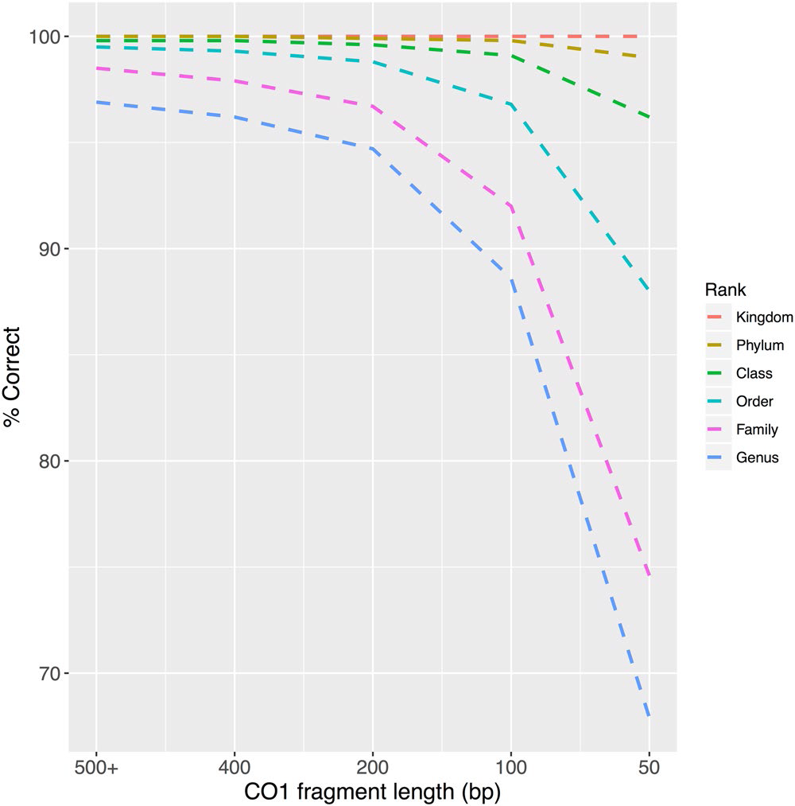
Classification metadata
African Arthropoda phylum;
11 classes
61 orders
562 families
3374 genera
9829 species
Ribosomal Database Project (RDP) classifier:
Data set | All Seqs | Seq.len over 500 | Species labeled (Sp) | Sp labeled & Seq.len over 500
All Diptera | 48137 | 47507 | 6629 | 6125
BS = 0.70 | 11337 | 10957 | 5124 | 4802
BS = 0.95 | 9244 | 8883 | 4785 | 4479
BS = 1.00 | 8049 | 7717 | 4407 | 4122
Porter and Hajibabaei (2018)

Slide 9
Results: workflow
Sorted data
MSA:
PASTA - Practical Alignment using Sate and TrAnsitivity
Phylogenetics:
BMGE - Block Mapping and Gathering with Entropy
RAxML:
Tree inference - GTRCAT
Bootstrapping
Rooting - Evolutionary Placement Algorithm (EPA)
MSA
Subset data
PASTA, MAFFT,
OPAL
Clean non- homologs
Visualise
Seaview
SuiteMSA
Jalview
MUSCLE (refine)
Trimming:
658 region
Phylogenetics
RAxML tree
BMGE
RAxML (BS)
FastTree
Visualise
Archaeopteryx
Dendroscope
Figtree
RAxML (EPA)

Slide 10
Results: workflow
Haplotype Networks
MSA output
Population Genetic Structure:
Haplotype networks - POPART, DNASP
Phylogeographic differentiation
diveRsity R (Jost’s D and F_{ST})
PERMUT CPSSR (G_{ST} and N_{ST})
Population spatial clusters (k) - GENELAND or SAMOVA
Mantel test - significance of correlation between genetic and geographical distances
haploNet (pegas R-pkg)
POPART
Statistical Tests
diveRsity (R-pkg)
PERMUT
CPSSR
GENELAND
(R-pkg)
SPADS 1.0
(SAMOVA)
Mantel test
Phylogeography:
Bayesian Structured Coalescent Approximation
ARLEQUIN {
AMOVA
Genetic diversity
Neutrality test
BEAST 2.5 (BASTA)

Slide 11
Preliminary conclusions
Key challenges are:
Missing/Inaccurate metadata-
taxonomic classification,
GPS, and
elevation data
Resulting phylogenies are gene trees, limit their accuracy as species trees

Slide 12
Preliminary conclusions
BOLD COI data can be used in a number of population biology studies within different elevation spectrum, localities or clades:
Phylogenetic diversity and gene flow
Population dynamics
Integrative taxonomy
Biomonitoring: Invasive species and potential pests and vectors

Slide 13







Thank you
Award Number: U24HG006941
International Centre of Insect Physiology and Ecology
P.O. Box 30772-00100, Nairobi, Kenya
Tel: +254 (20) 8632000
E-mail: icipe@icipe.org
Website: www.icipe.org
facebook.com/icipe.insects/icipe
twitter.com/icipe
linkedin.com/company/icipe
Support icipe: www.icipe.org/support-icipe

